Slide 1

BHARATI VIDYAPEETH’S COLLEGE OF ENGINEERING
A-4 PASCHIM VIHAR, DELHI
OPTICAL TABLE GENERATOR
UNDER THE GUIDANCE OF
Mr. Vishal Sharma
(Assistant professor, CSE department)
SUBMITTED BY
Sanjeev Sharma(01911502713)
Chandan Malla (03811502713)
Himanshu Bansal (02311502713)
Ankit Dahiya (01111502713)
Feburary 2017

Slide 2
Topics to be covered
Introduction
Objective
Software Language Used
Working
Future Scope
References

Slide 3
introduction
Optical Table Generator is a process by which the scanner "recognizes" tables as well as blocks of text. Optical Table Generator is achieved with the help of OCR and OpenCV. Optical Table Generator works because Image processing technology is able to recognize certain kinds of characters, lines or other shapes and distinguish them from each other with appropriate algorithms and methods.

Slide 4
Objective
The aim of the project is to analyze and propose solutions to develop a software which will convert handwritten or printed text into editable and searchable tabular data., and to develop general purpose templates of the proposed solutions in commonly used programming languages. We plan to make solution codes public and free for educational purposes. We also tend to provide detailed description and tutorials for image processing used along with the test data created for testing purposes.

Slide 5
Software and Languages used
Python
OpenCV

Slide 6
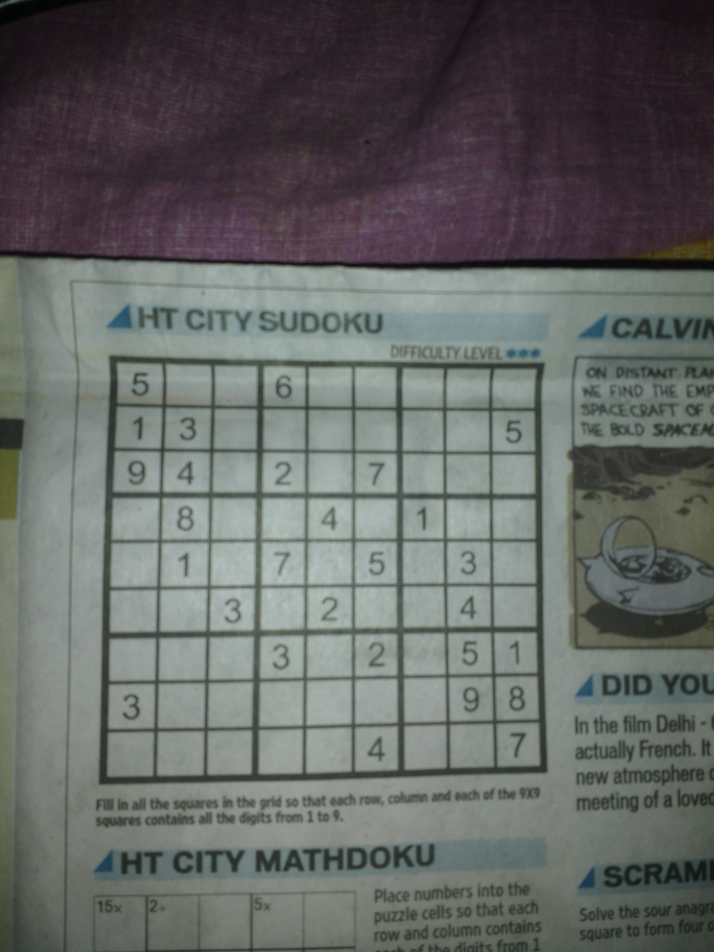
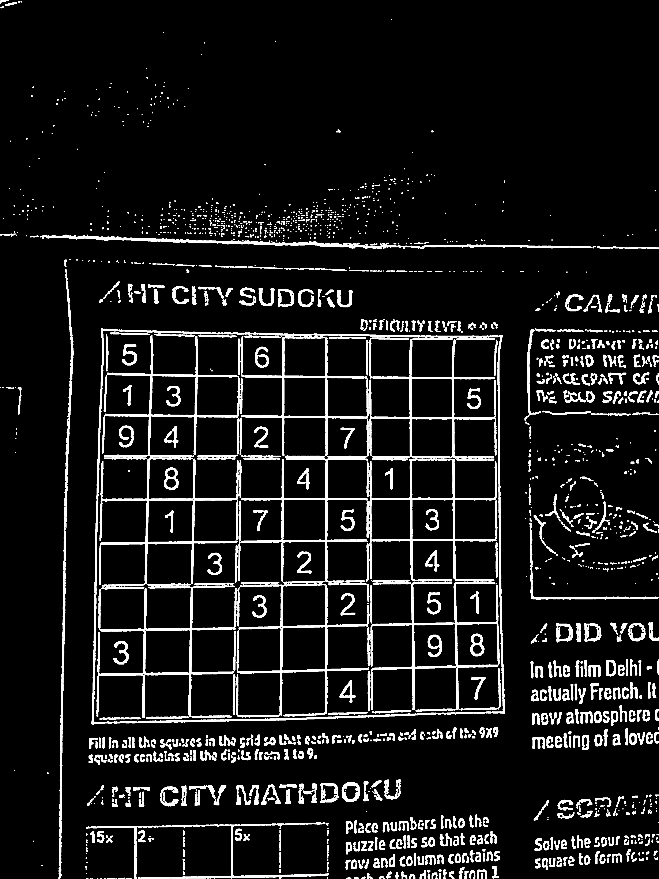
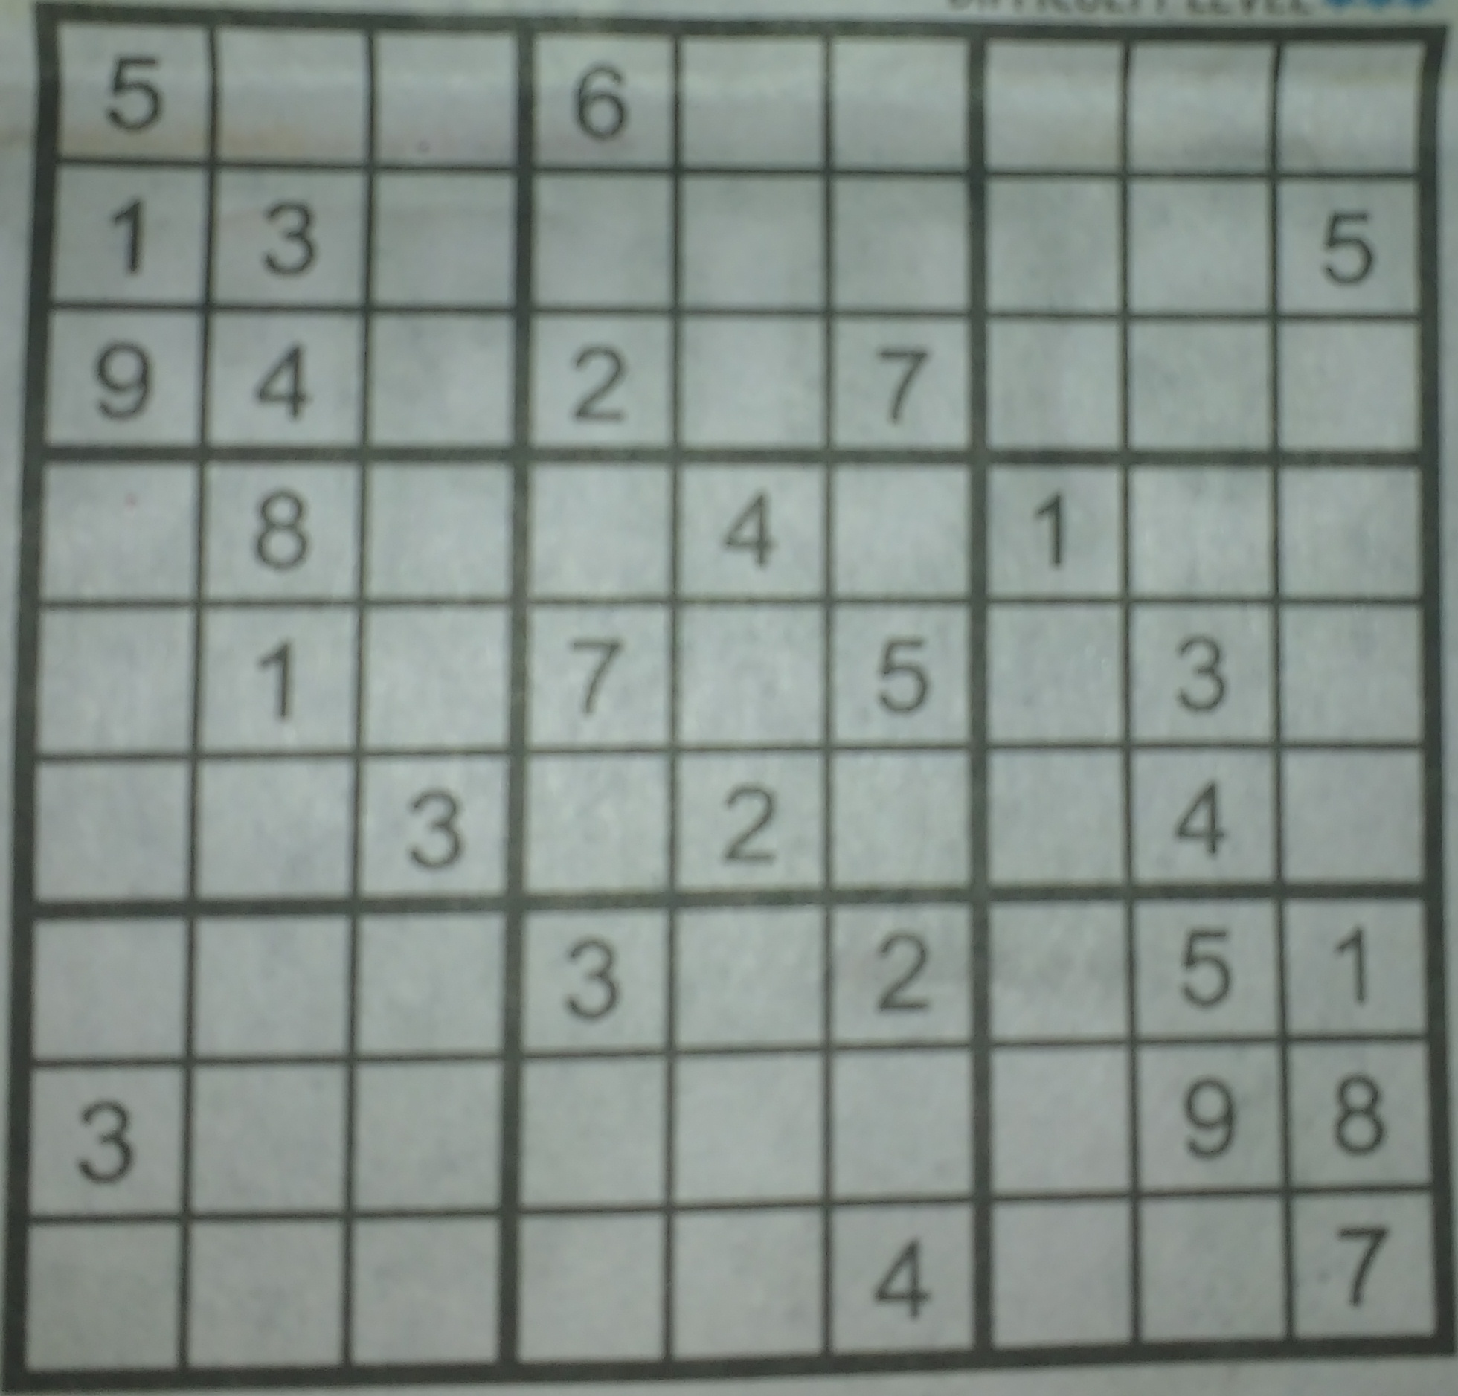
Working Step 1 Preprocessing the image
Pre Processed Test image
Extracted Table
Test image

Slide 7
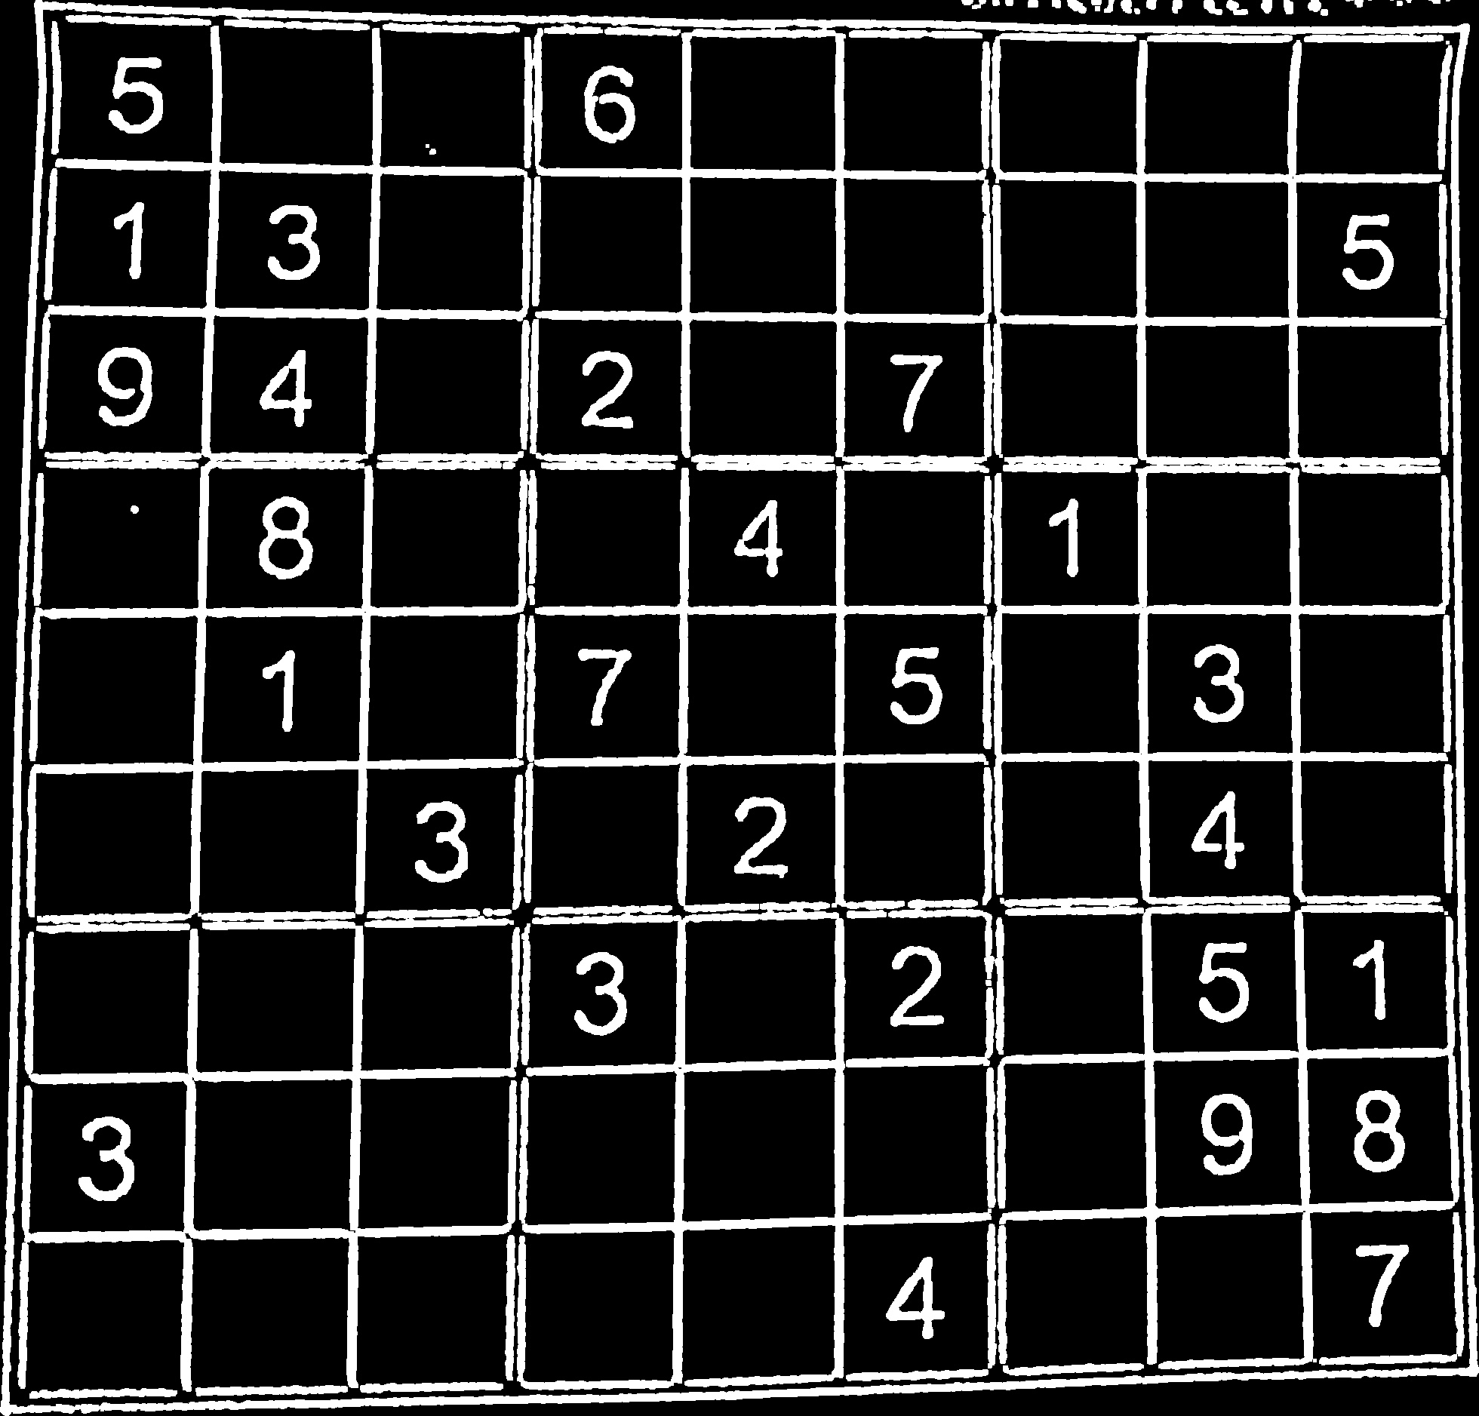
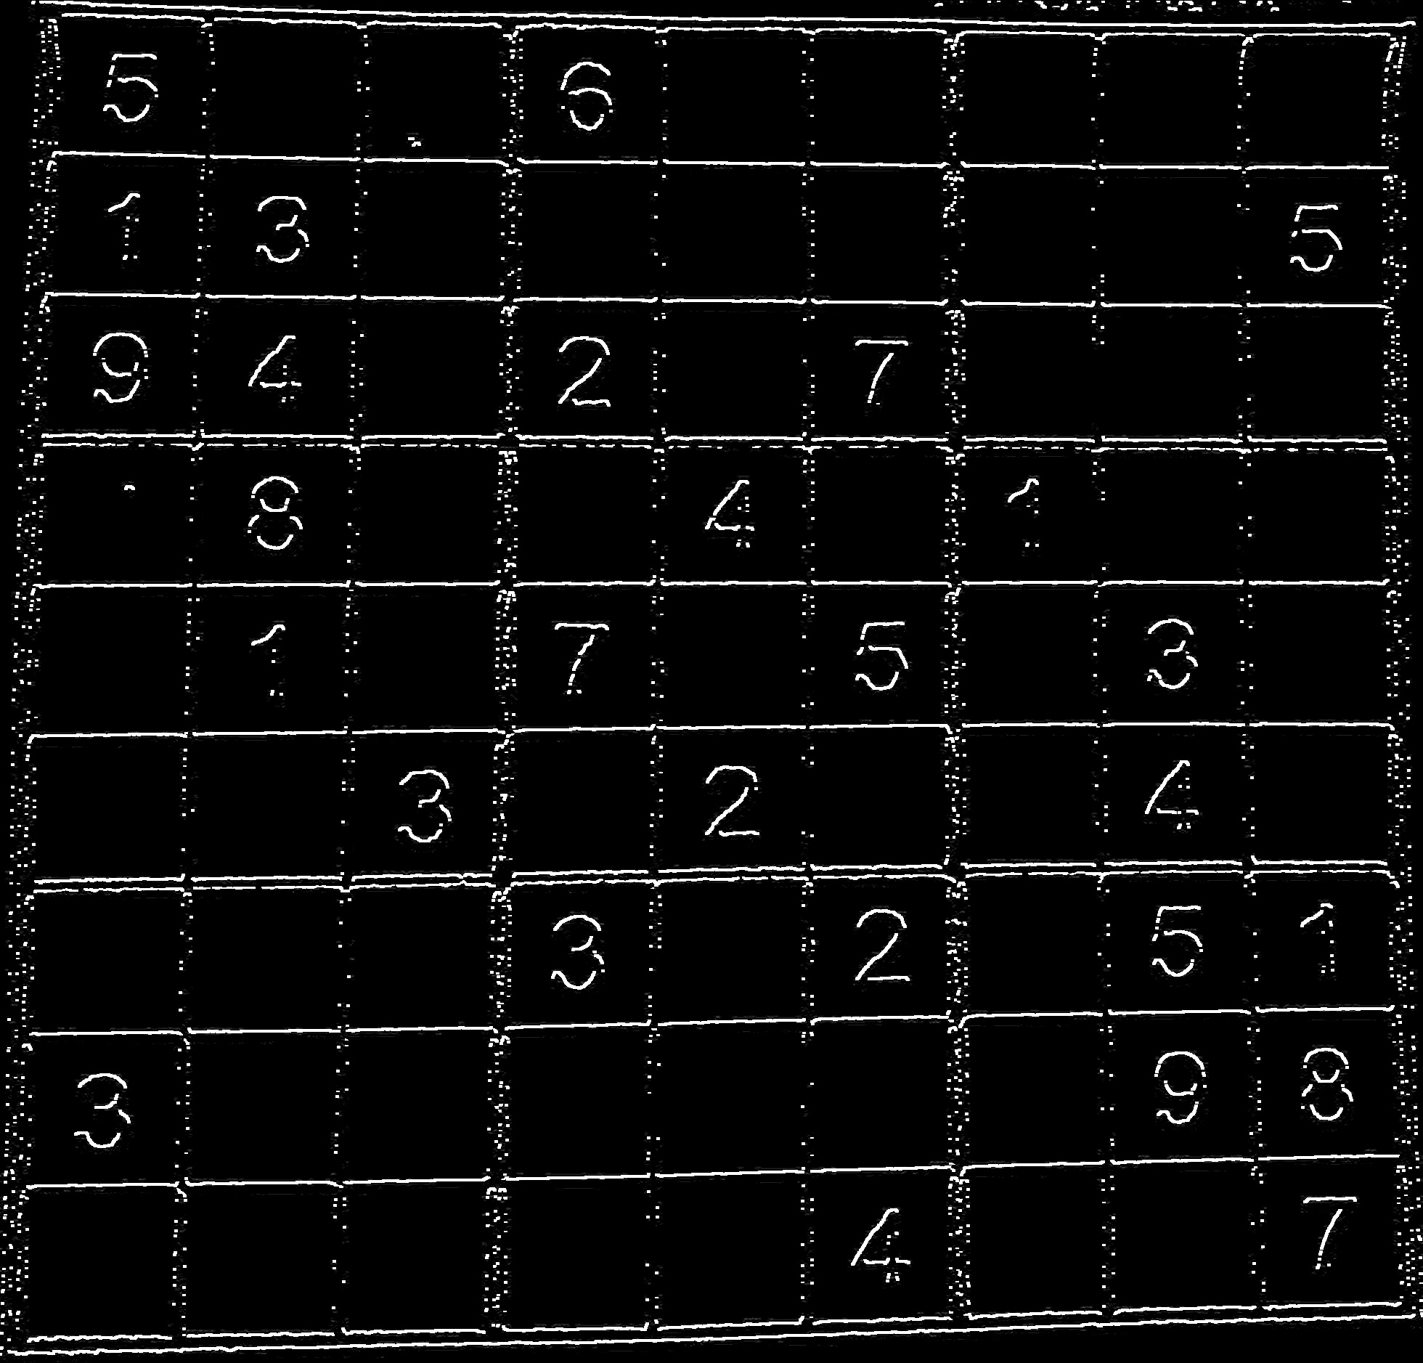
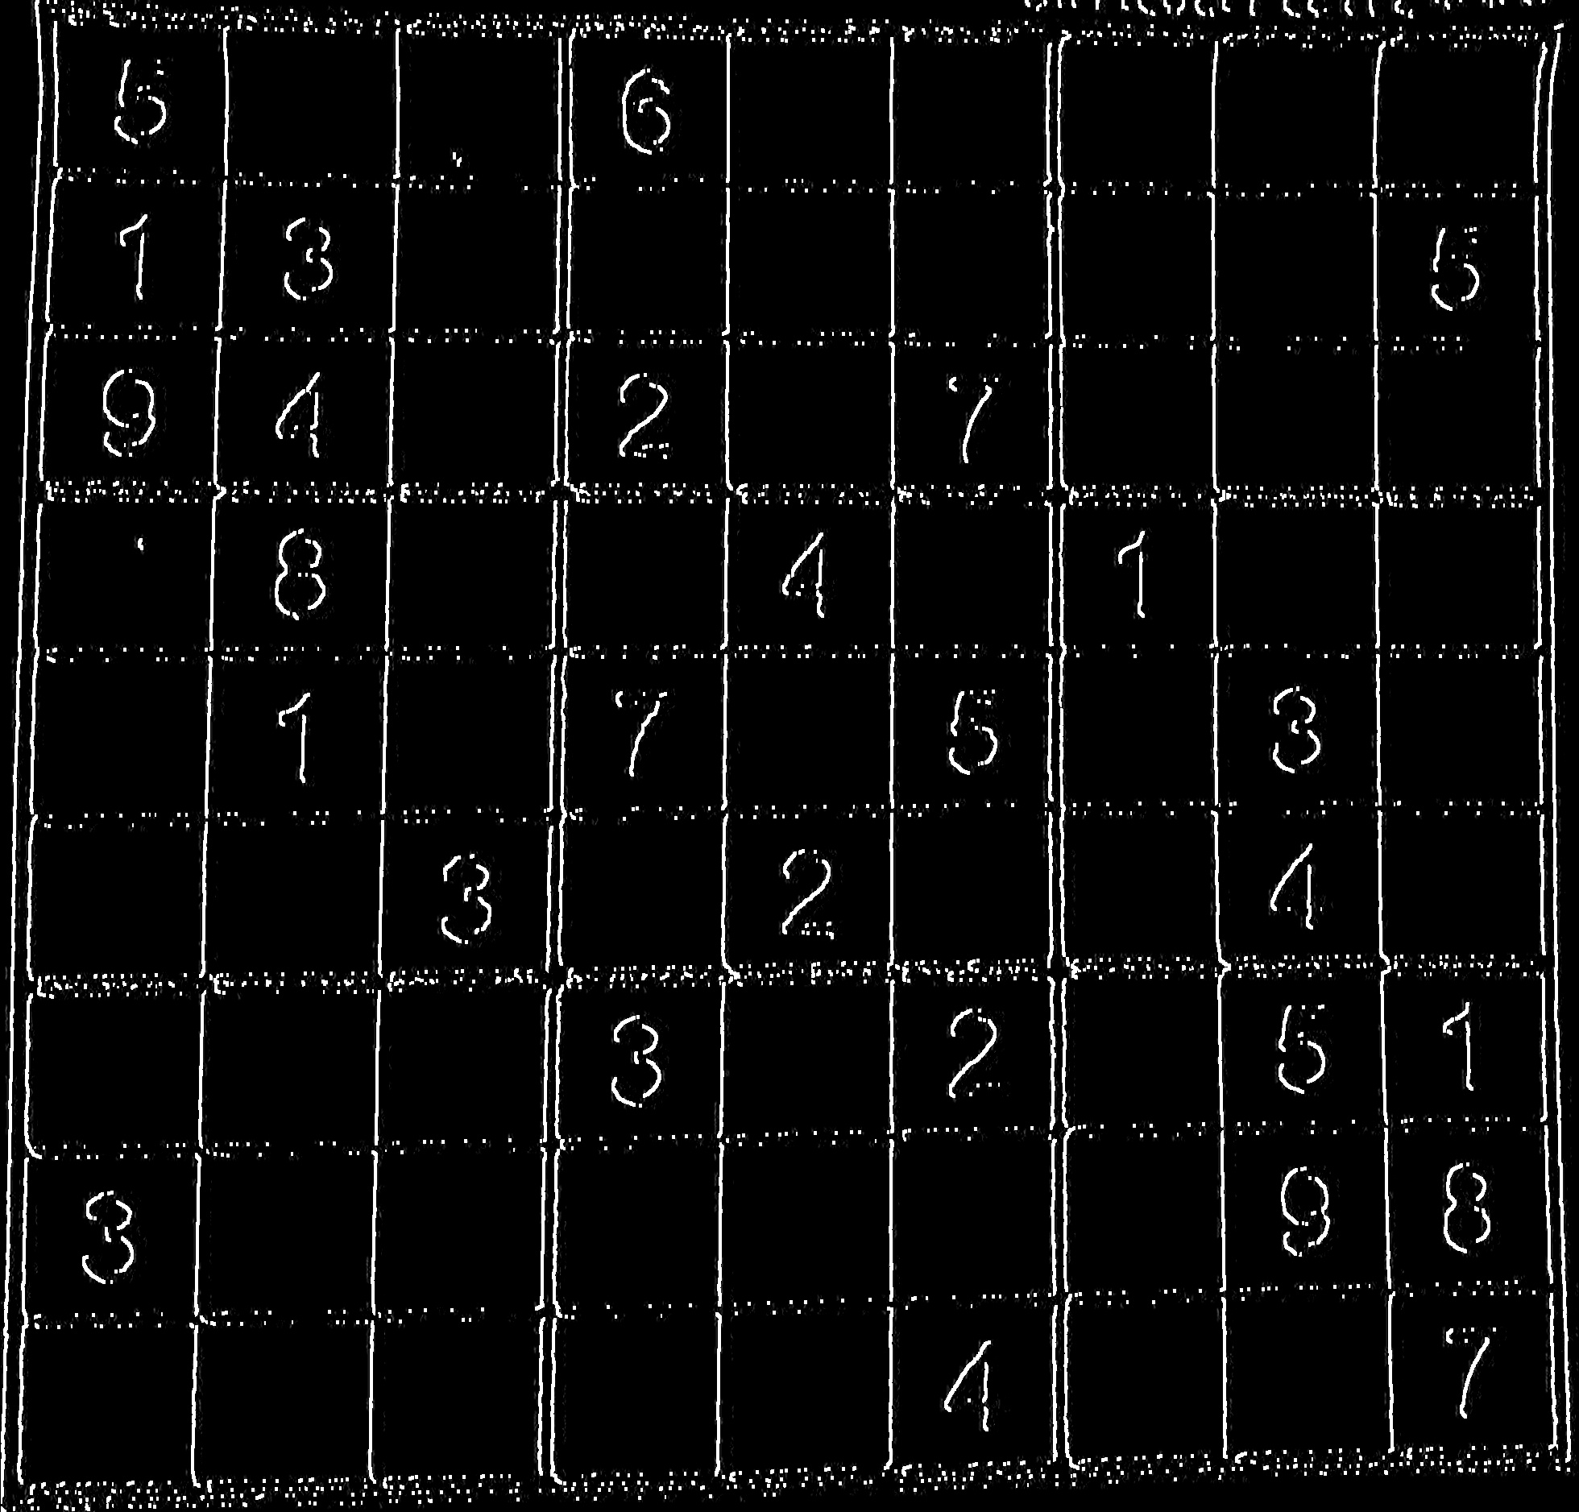
Step 2 Separate Horizontal and vertical component
Pre processed Test Image
Vertical Component of image
Horizontal Component of image

Slide 8
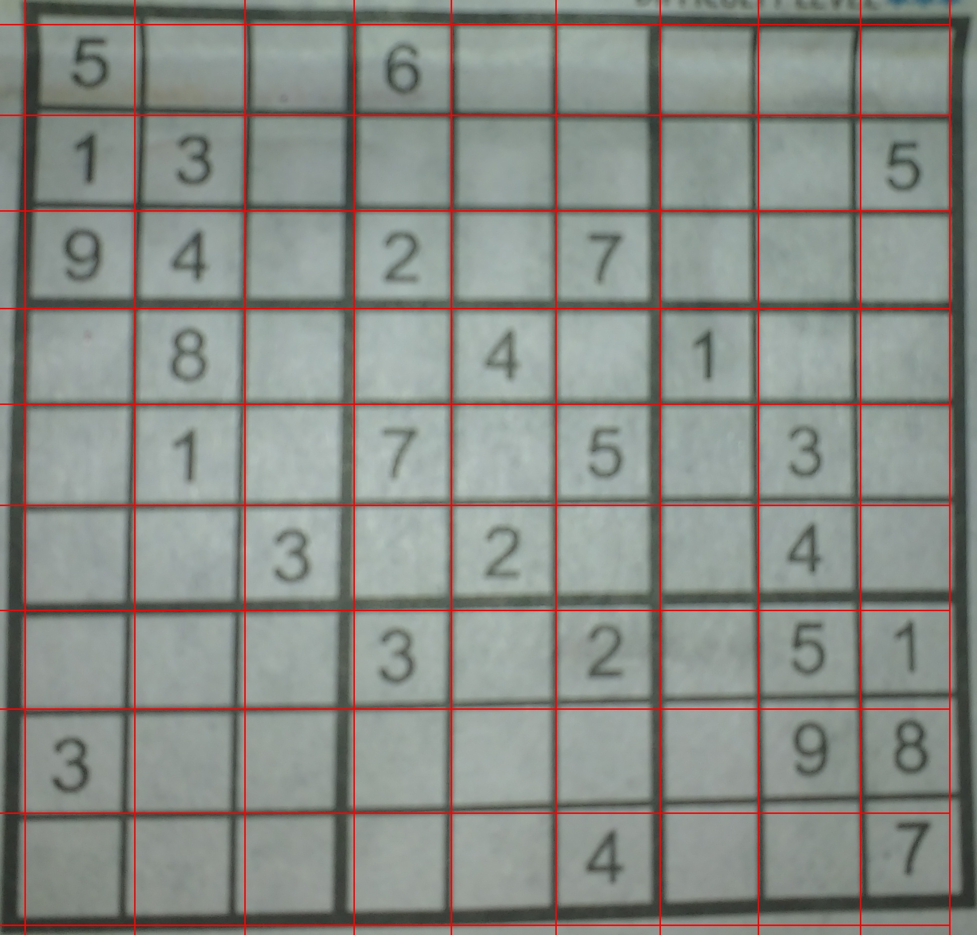
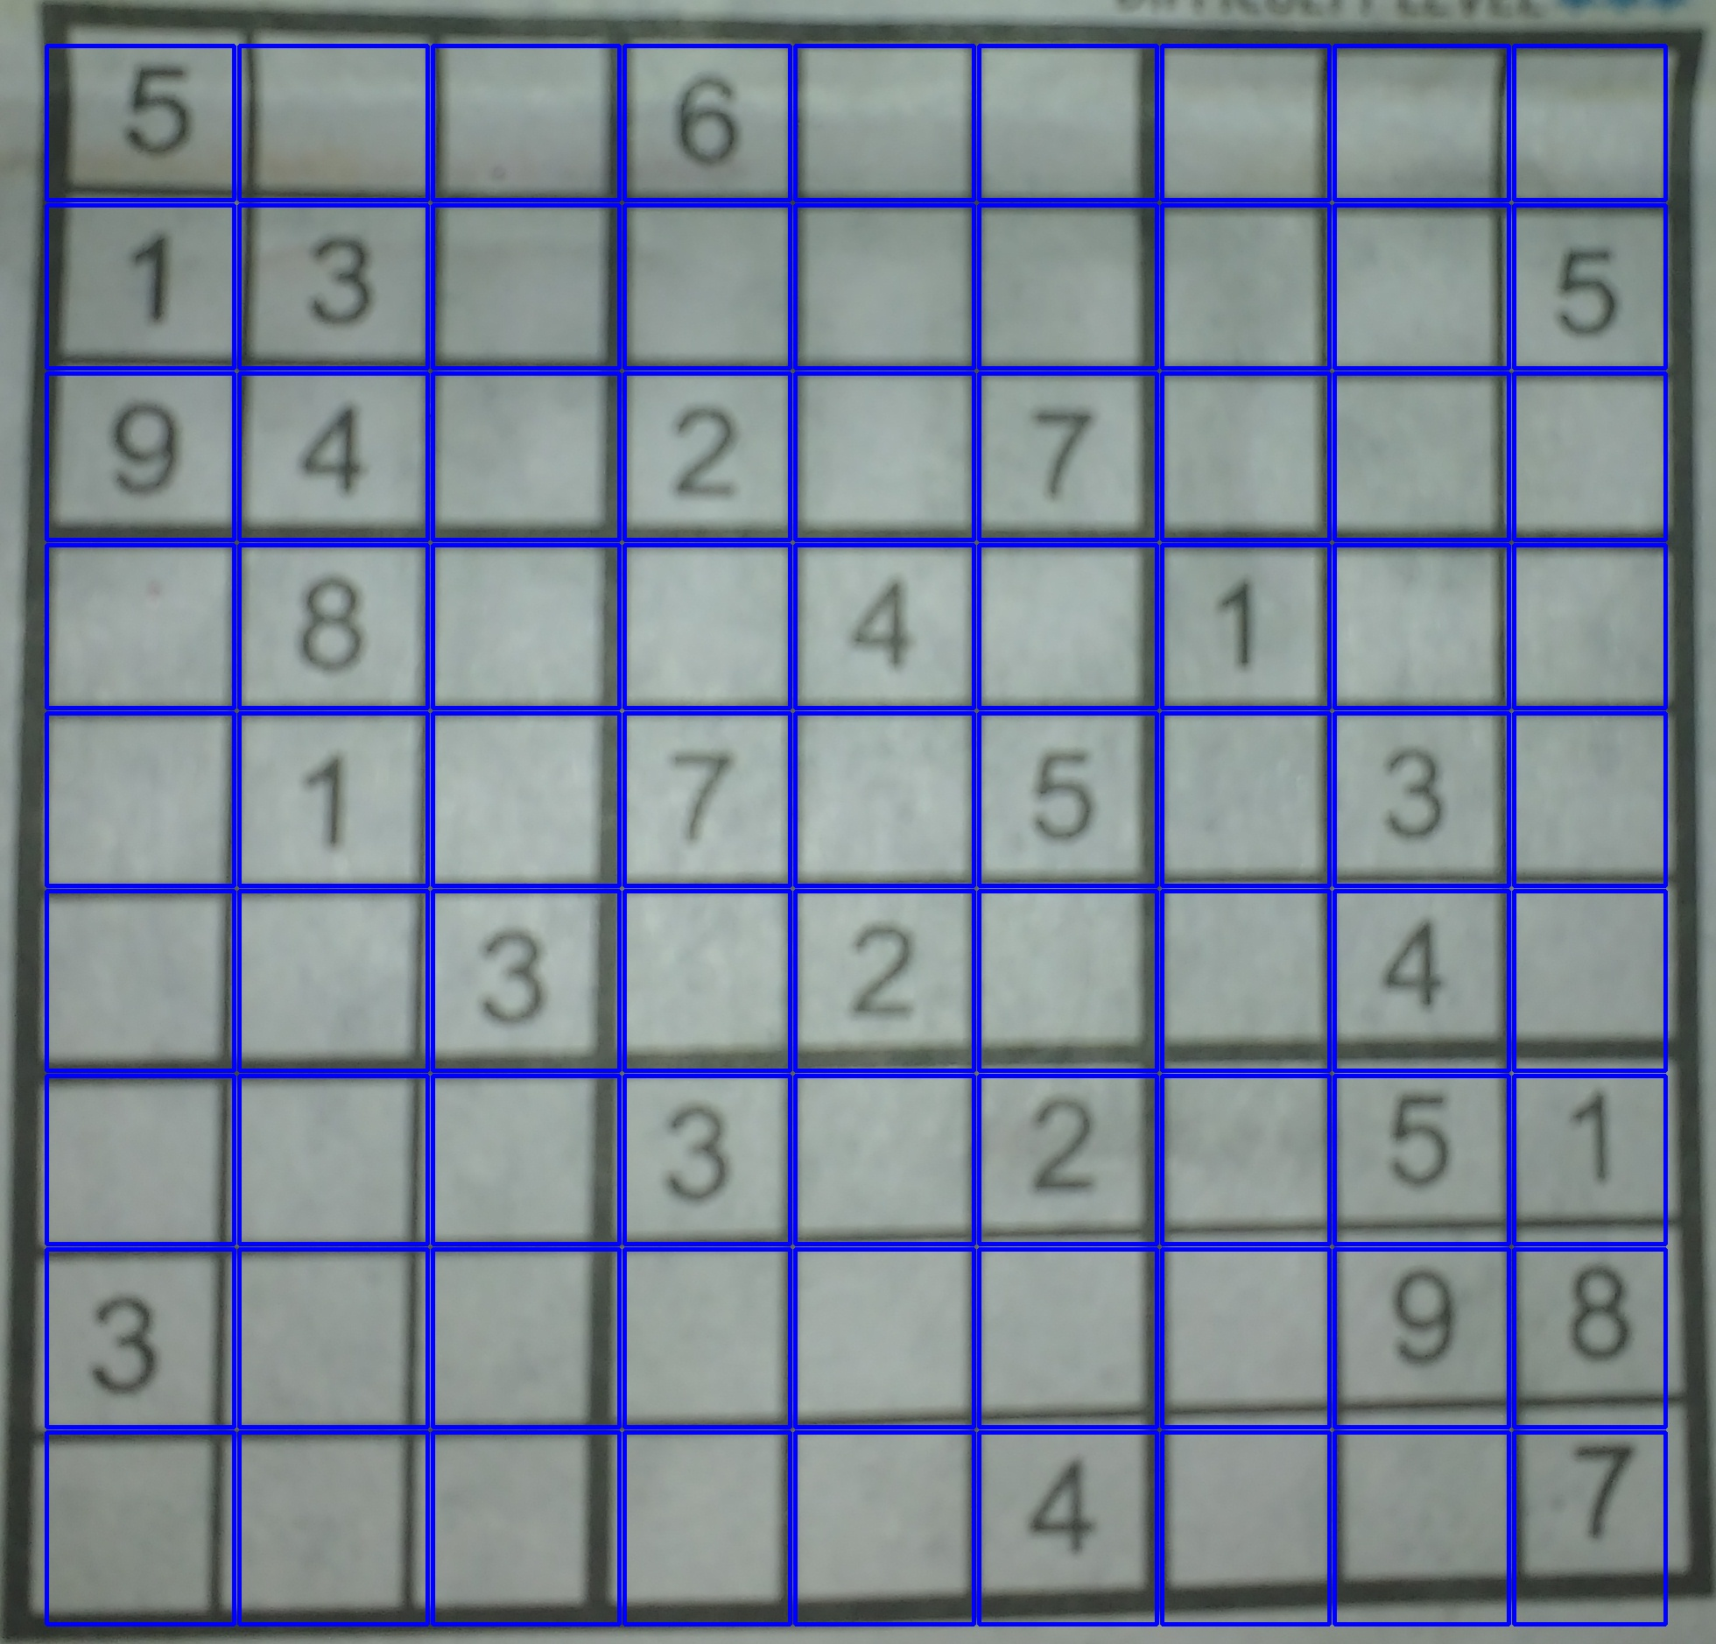
Step 3 dividing image into blocks
Cells of the table (Blue Boxes)
Detected Lines (Red Lines)

Slide 9
Future scope
Future Scope for OTG is very vast. With technology like this anyone can scan a table from a magazine, a book or a document in seconds and can have digital copy of it with him forever and if you have a series of complicated tables as part of a larger image OTG will be extremely useful to be able to extract them with a scanner and edit them on screen. With further advancement it can be even more accurate than human eye.

Slide 10
References
Optical Character Recognition https://en.wikipedia.org/wiki/Optical_character_recognition
OpenCV https://en.wikipedia.org/wiki/OpenCV
Extracting data from PDF tables https://web.archive.org/web/20141022033241/http://craiget.com/extracting-table-data-from-pdfs-with-ocr/
“Can OCR software reliably read values from a table?” http://stackoverflow.com/questions/6173439/can-ocr-software-reliably-read-values-from-a-table

Slide 11

Thank you

